Slide 1
手寫HW9 - ( I ) 小題
第 26 組
資工三 108502205 謝瑄
資工二 108101505 馬霈玲
資工二 109502545 陳映樺

Slide 2
I. 證明集團問題(clique problem)為NP問題。

Slide 3
簡介：NP問題及集團問題 (clique problem)
NP問題 可以用非確定性演算法(non-deterministic algorithm)在多項式時間內解決的問題，便稱為NP問題。
集團問題(clique problem)
集團問題(k)(CLIQUE(k)): G=(V,E) 是否包含一個集團(clique)，其大小≥ k?
集團(clique) 在圖中的集團(clique)是一個多點的集合，其集合必須滿足當中的任意點對之間存在邊將兩者相連。
Notes:
Certificate – Let the certificate be a set S consisting of nodes in the clique and S is a subgraph of G.
Verification – We have to check if there exists a clique of size k in the graph. Hence, verifying if number of nodes in S equals k, takes O(1) time. Verifying whether each vertex has an out-degree of (k-1) takes O(k2) time. (Since in a complete graph, each vertex is connected to every other vertex through an edge. Hence the total number of edges in a complete graph = kC2 = k*(k-1)/2 ). Therefore, to check if the graph formed by the k nodes in S is complete or not, it takes O(k2) = O(n2) time (since k<=n, where n is number of vertices in G).

Slide 4
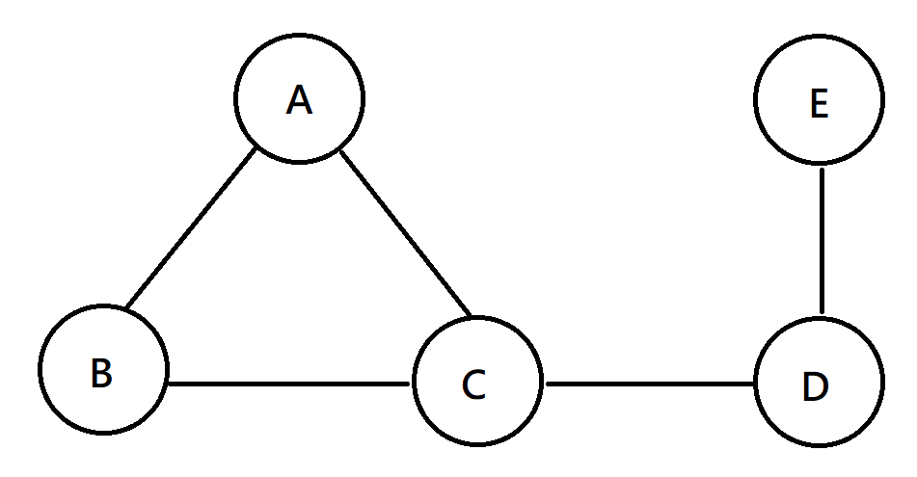
集團(clique)
k=3的集團
k=2的集團
不是集團，C與E之間沒有邊

Slide 5
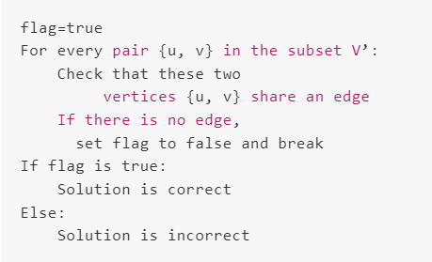
證明集團問題(clique problem)為NP問題
給定一個圖 G=(V,E)，其有 n 個點。
第一步驟：Guessing
選取一個包含 k 個點的子集合 S，猜測 S 是一個集團(clique)，且 S 是圖 G 的子圖。 因遍歷 n 個點，所以時間複雜度為 O(n)。
第二步驟：Checking
確認集合S中的每對點之間都相鄰， 我們只需要確認兩個點是否共享一條邊， 而邊的數量 = k*(k-1)/2 所以我們檢查每一個邊的時間複雜度為 O(k^2)，為多項式時間複雜度
Notes:
Certificate – Let the certificate be a set S consisting of nodes in the clique and S is a subgraph of G.
Verification – We have to check if there exists a clique of size k in the graph. Hence, verifying if number of nodes in S equals k, takes O(1) time. Verifying whether each vertex has an out-degree of (k-1) takes O(k2) time. (Since in a complete graph, each vertex is connected to every other vertex through an edge. Hence the total number of edges in a complete graph = kC2 = k*(k-1)/2 ). Therefore, to check if the graph formed by the k nodes in S is complete or not, it takes O(k2) = O(n2) time (since k<=n, where n is number of vertices in G).

